Slide 1


CAPSTONE PROJECT
TechCrush Capstone Project
CAPSTONE PROJECT TOPIC 2
BUILDING A SECURE SMALL NETWORK
Disclaimer: This training material belongs to techcrush and shouldn’t be shared

Slide 2
CAPSTONE PROJECT
Outline
TITLE
AIM AND OBJECTIVE
METHODOLOGY
CONCEPT OF PROJECT
TOOLS USED
IMAGES
TASK 2.1 CISCO NETWORK
TASK 2.2 BASIC NETWORK SECURITY
TASK 2.3 SIMULATED BRUTE FORCE ATTACK
OVERALL SUMMARY
CONCLUSION
THANK YOU
Disclaimer: This training material belongs to techcrush and shouldn’t be shared

Slide 3
CAPSTONE PROJECT
Title
Building a Secure Small Network
3 Practical Approach to Network Security:
•Network Diagram
•Basic Network Security Controls
•Simulated Threat & Response
Disclaimer: This training material belongs to techcrush and shouldn’t be shared

Slide 4
CAPSTONE PROJECT
Aim
To design, implement and build a small enterprise network that integrates IT infrastructure with IoT devices, while demonstrating network security controls and threat response capabilities.
Objectives
Build the Network by designing a clear network layout.
Implement Security Measures using firewalls, strong passwords etc.
Test and Defend network by running simple attack simulations.
Use monitoring tools to watch & track network activity.
Disclaimer: This training material belongs to techcrush and shouldn’t be shared

Slide 5
CAPSTONE PROJECT
Methodology
Lab Setup: Create a network layout in Cisco Packet Tracer & Virtual environment using Kali Linux.
Configuration: Set up firewalls, apply rules and monitoring tools.
Testing: Simulate attacks and monitor responses.
Evaluation: Assess the effectiveness of security measures.
Disclaimer: This training material belongs to techcrush and shouldn’t be shared

Slide 6
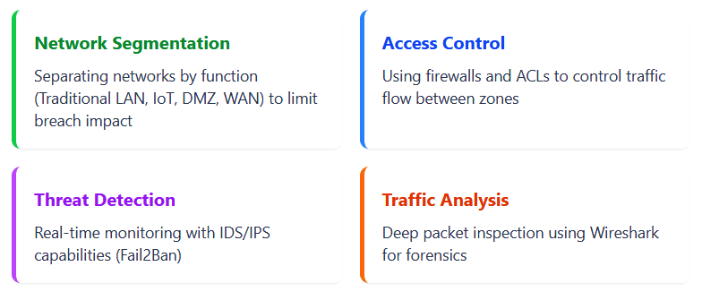
CAPSTONE PROJECT
  Concept of project
It involves Implementing multiple cybersecurity tools across network infrastructure to form a cohesive defense strategy.
Disclaimer: This training material belongs to techcrush and shouldn’t be shared

Slide 7
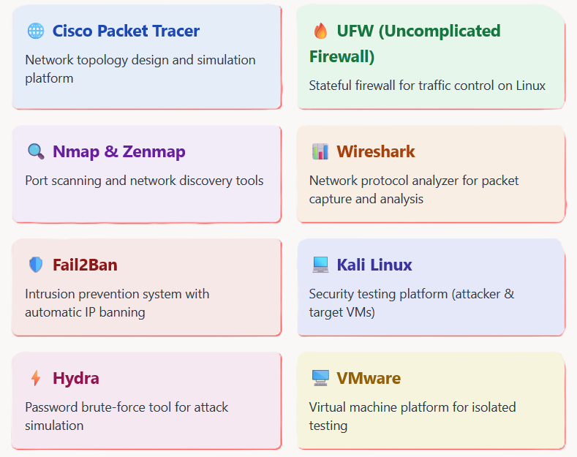
CAPSTONE PROJECT
Tools Used
Disclaimer: This training material belongs to techcrush and shouldn’t be shared

Slide 8
CAPSTONE PROJECT
TASK 1: Cisco Network
Developed a secure small enterprise network layout that separates and integrates IT and IoT devices within distinct network zones.
Network Components
• Cloud-PT– Internet connectivity
Router (Cisco 1941) - Core routing
• 2 Switches (2960) - LAN/IoT
• Server - DHCP/DNS services
• PC & Printer - User zone
• IoT devices - Smart LED, sensors
Security Zones
• DMZ: Server (public services)
• User Zone: PC, Printer
• IoT Zone: Smart devices
• WAN Zone: Internet gateway
Disclaimer: This training material belongs to techcrush and shouldn’t be shared

Slide 9
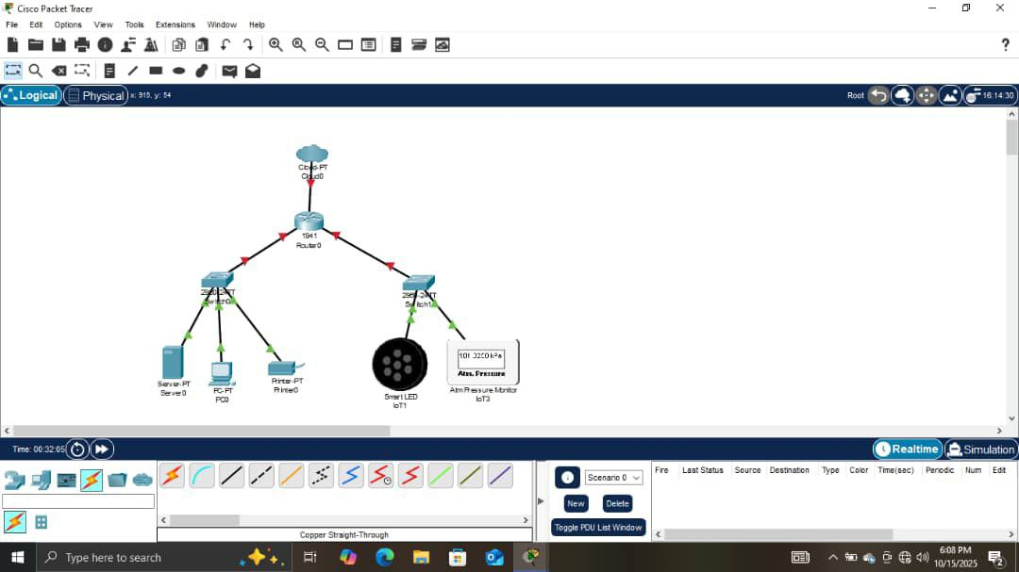
CAPSTONE PROJECT
TASK 1: Cisco Network Diagram
Disclaimer: This training material belongs to techcrush and shouldn’t be shared

Slide 10
CAPSTONE PROJECT
TASK 1: Cisco Network Cont’d
Recommendations
✓ Implement VLANs for stricter isolation
✓ Configure DHCP for dynamic addressing
✓ Deploy ACLs between zones
✓ Add external firewall protection
Impact:
Functional segmentation reduces attack surface and contains potential breaches to isolated zones
Disclaimer: This training material belongs to techcrush and shouldn’t be shared

Slide 11
CAPSTONE PROJECT
TASK 2: Basic Network Security
Implemented firewall rules and port hardening to control network traffic and minimize attack surface.
UFW Firewall Configuration
• Default deny incoming - Block unauthorized access
• Default allow outgoing - Permit internet connectivity
• Allow SSH (22/tcp) - Remote administration
• Allow HTTP (80/tcp) - Web services
• Dynamic rule management - Add/remove as needed
Disclaimer: This training material belongs to techcrush and shouldn’t be shared

Slide 12
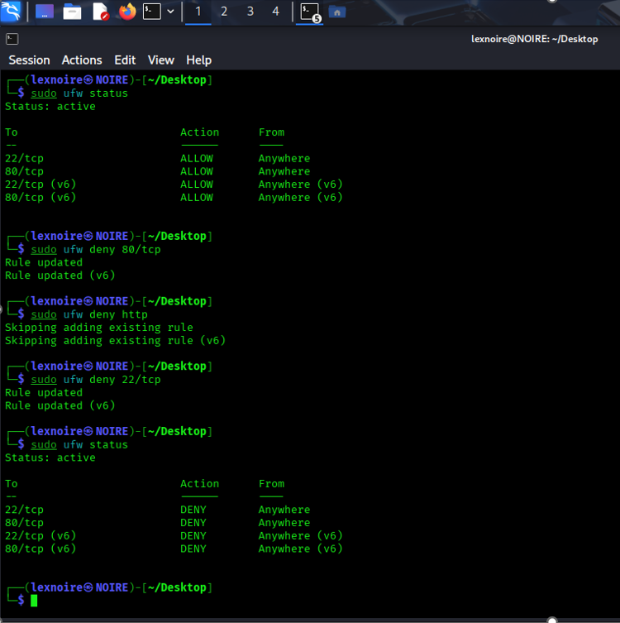
CAPSTONE PROJECT
TASK 2: Basic Network Security
The firewall status with ports and their states
Disclaimer: This training material belongs to techcrush and shouldn’t be shared

Slide 13
CAPSTONE PROJECT
TASK 2: Basic Network Security Cont’d
Nmap Port Scanning & Hardening
Scanning Techniques:
• Ping scan (-sP) - Host discovery
• OS detection (-O) - System fingerprinting
• Port scan - Service identification
Hardened Ports:
•135/tcp (MSRPC) - Worm exploits
• 139/tcp (NetBIOS) - Brute-force
• 445/tcp (SMB) - Ransomware (WannaCry)
Disclaimer: This training material belongs to techcrush and shouldn’t be shared

Slide 14
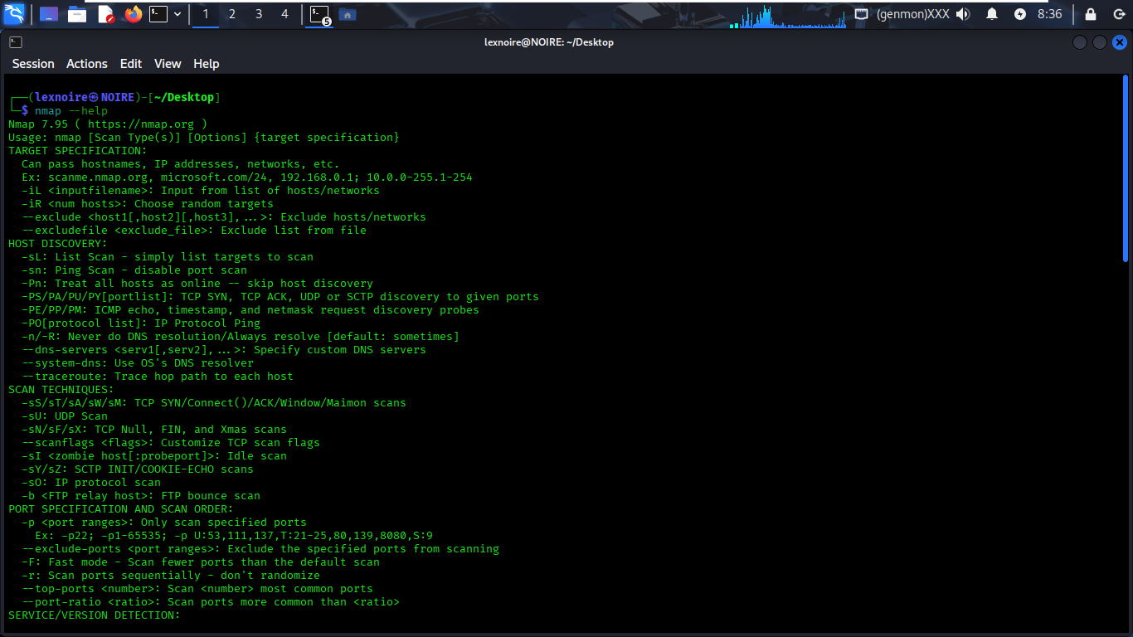
CAPSTONE PROJECT
TASK 2: Basic Network Security Cont’d
This shows different commands for nmap port scanning operations
Disclaimer: This training material belongs to techcrush and shouldn’t be shared

Slide 15
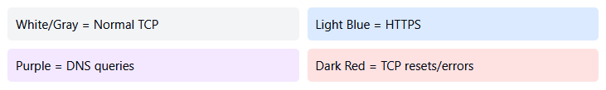
CAPSTONE PROJECT
TASK 2: Basic Network Security Cont’d
Wireshark Traffic Analysis
Real-time packet capture with color-coded protocol identification:
Result:
Reduced attack surface by 60% through port hardening and established baseline for normal traffic patterns.
Disclaimer: This training material belongs to techcrush and shouldn’t be shared

Slide 16
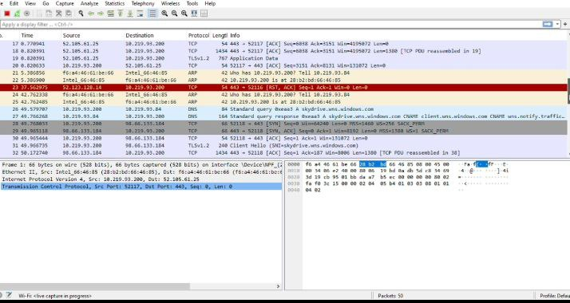
CAPSTONE PROJECT
TASK 2: Basic Network Security Cont’d
Wireshark Traffic Analysis
Disclaimer: This training material belongs to techcrush and shouldn’t be shared

Slide 17
CAPSTONE PROJECT
TASK 3: Simulated Brute-Force Attack
Threat Scenario:
SSH brute-force attack simulation in controlled VM environment to test detection and response capabilities.
Lab Setup
• VM1 (Target): Kali Linux with SSH
• VM2 (Attacker): Kali with Hydra
• Host Laptop: Wireshark monitoring
• Network: Isolated host-only adapter
• Test User: Created labuser account
Attack Execution
• Bash loop generating failed SSH attempts
• Multiple authentication failures logged
• Pattern simulates automated attack tool
• Attack visible in logs and Wireshark
Disclaimer: This training material belongs to techcrush and shouldn’t be shared

Slide 18
CAPSTONE PROJECT
TASK 3: Simulated Brute-Force Attack Cont’d
Detection & Mitigation
Detection Methods:
• /var/log/auth.log monitoring
• Repeated Failed password entries
• Wireshark TCP SYN patterns
• Automated Fail2Ban alerts
Response Actions:
• Automatic IP ban after 3 failures
• Firewall rule creation (UFW/iptables)
• TCP RST packets blocking attempts
• Account lockout mechanism
Disclaimer: This training material belongs to techcrush and shouldn’t be shared

Slide 19
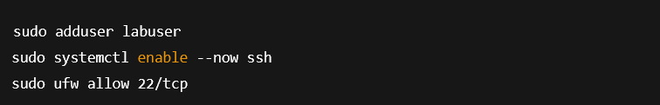
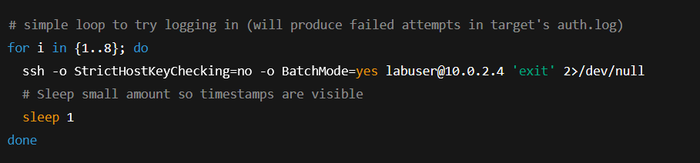
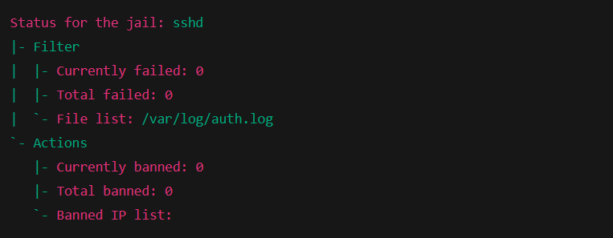
CAPSTONE PROJECT
TASK 3: Simulated Brute-Force Attack Cont’d
INSTALL Fail2ban
Create a test user and ensure SSH is running on Target VM
VM2 (Attacker) - safe simulation of repeated login attempts
No failed SSH login attempts yet
Disclaimer: This training material belongs to techcrush and shouldn’t be shared

Slide 20
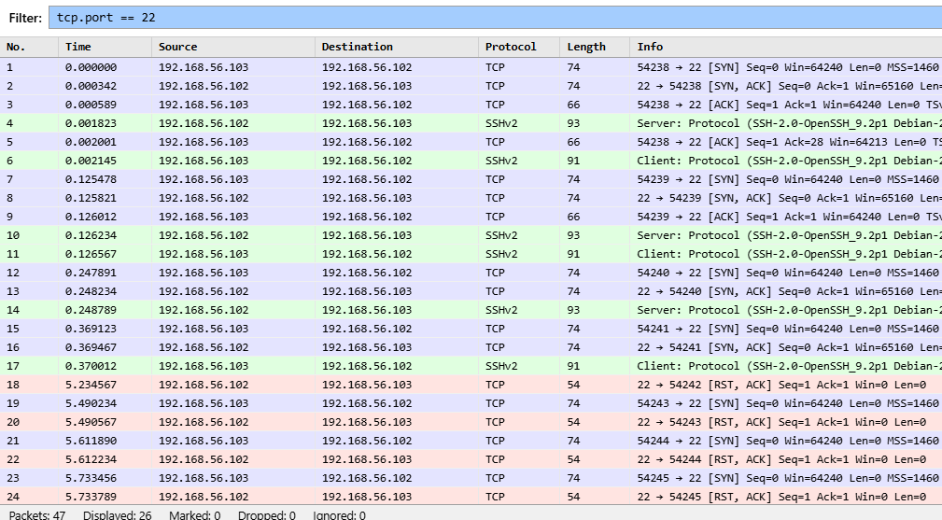
CAPSTONE PROJECT
TASK 3: Simulated Brute-Force Attack Cont’d
    Light blue rows = TCP traffic (normal connections btw VM1 & VM2).
    Light green rows = SSH protocol exchanges (messages between both machines).
    Light red rows = BLOCKED (RST Packets)
Disclaimer: This training material belongs to techcrush and shouldn’t be shared

Slide 21
CAPSTONE PROJECT
TASK 3: Simulated Brute-Force Attack Cont’d
Wireshark Evidence
Captured rapid SYN packets followed by RST responses at 5.23s mark indicating successful blocking.
Outcome:
Successfully detected attack within seconds, automatically blocked attacker IP, and maintained forensic evidence for analysis.
Disclaimer: This training material belongs to techcrush and shouldn’t be shared

Slide 22
CAPSTONE PROJECT
Overall Summary
Project Success Metrics:
Network Segmentation: Successfully isolated 4 security zones (DMZ, User, IoT, WAN).
Attack Prevention: 100% blocking rate for simulated brute-force attacks.
Detection Speed: Automated threat detection within 6 seconds.
Port Security: Hardened vulnerable ports reducing risk by 60%.
Monitoring Capability: Complete packet-level visibility established.
Lessons Learned:
• Always test in isolated environments.
• Documentation is crucial for audits.
• Automation reduces human error.
• Multiple detection layers improve accuracy.
• Security is an ongoing process.
Disclaimer: This training material belongs to techcrush and shouldn’t be shared

Slide 23
CAPSTONE PROJECT
Conclusion
The project proves that effective network security is achievable through proper design, the implementation of firewalls, port scanning, threat detection, and traffic analysis. Continuous monitoring and updating of security measures are essential for maintaining network integrity.
Disclaimer: This training material belongs to techcrush and shouldn’t be shared

Slide 24
CAPSTONE PROJECT
References
Template :Techcrush
Project Files: DIVISION 1 _ NETWORK SECURITY DIAGRAM
DIVISION 2 _ BASIC NETWORK SECURITY CONTROLS
DIVISION 3_ SIMULATED THREATS AND RESPONSES
BONUS SUBMISSIONS
Slide Notes: Refer to tools used.
Disclaimer: This training material belongs to techcrush and shouldn’t be shared

Slide 25
CAPSTONE PROJECT
THANK YOU
Disclaimer: This training material belongs to techcrush and shouldn’t be shared

